Slide 1


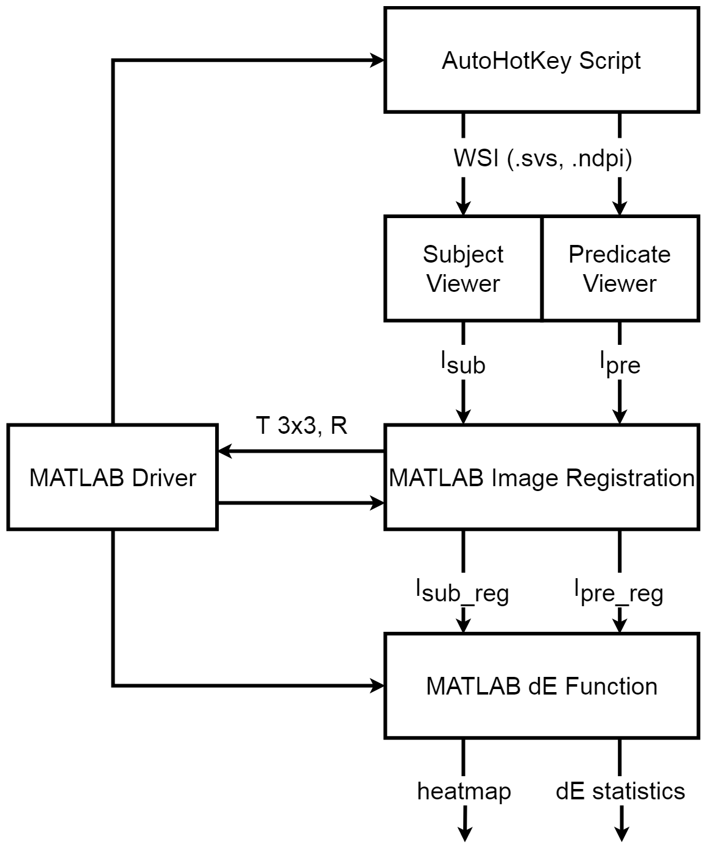

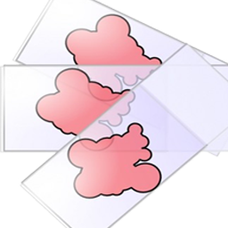


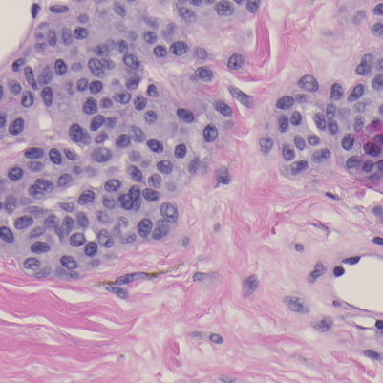
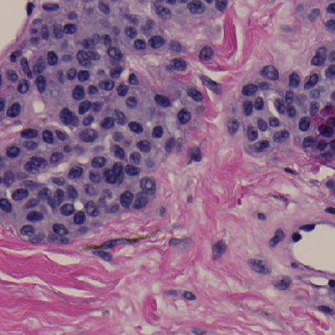
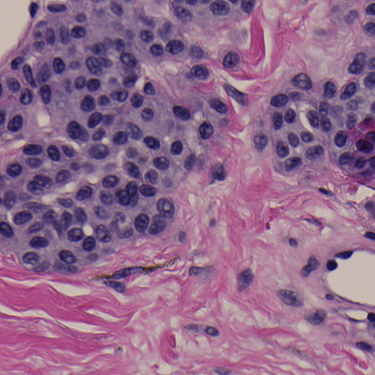

Third-party whole-slide image viewers do not produce the same image
Samuel Lam¹, Qi Gong², Wei-Chung Cheng³
¹University of Maryland, College Park; ²CDRH/OSEL/DIDSR
REGULATORY RELEVANCE
METHODOLOGY
Experiments showing that testing data are required to demonstrate image integrity for 3rd-party WSI viewer software.
AutoHotKey Script:
Use different viewers to open the same WSI
Use a keyboard/mouse event generator to interact with the viewers to obtain the ROI
Capture the screenshot in Windows (this captures color information in the digital domain and does not involve the display) [1]
MATLAB:
Run registration; check registration accuracy
Calculate color difference ∆E for each pixel
Report statistics (mean, standard deviation)
Generate graphs for display
ABSTRACT
In this study, three freely available 3rd-party image viewers were compared with the factory viewer. A software tool was developed to compare them on the pixel level. The results show that some of the viewers rendered the whole slide images very differently compared with the factory one.
RESULTS
BACKGROUND
NDP.view2
ASAP
QuPath
Sedeen
A WSI system used in digital pathology consists of the scanner, image viewer, and display components. Recently, some independent image viewers were submitted by third-party companies to replace the factory image viewer component used in the predicate device. To demonstrate substantial equivalence between the former and the latter, sponsors were expected to provide bench testing data for review. However, the sponsors frequently did not test their image viewers adequately for image quality.
FINDINGS
NDP.view2 and Sedeen generated similar but not identical images
ASAP and QuPath generated similar images
Large color differences between the two groups
Use of color profile is questionable
JPEG compression artifacts are prominent when comparing certain pairs of viewers.
Blank/void areas remain very similar between viewers.
RESEARCH QUESTION
REFERENCES
Do different WSI viewers generate identical images for the same WSI file?
Sun, C., Cheng, W-C., How Much Can Bad Display Cost? FDA Summer Student Poster Day 2018.
TEST SUBJECTS
NDP.View2 from Hamamatsu (the reference)
Sedeen from PathCore
QuPath from Queen’s University Belfast
ASAP from Radboud University
ACKNOWLEDGEMENTS
This study was supported by ORISE. The mention of commercial products herein is not to be construed as either an actual or implied endorsement of such products by the Department of Health and Human Services. We are grateful to Jonathan Boswell for helping in setting up this study.

